Slide 1

HTTP Protocol
How the World Wide Web works!
CNSA Week 7

Slide 2
AGENDA
1.
4.
Introduction
Headers and Requests
2.
5.
Intro to TCP & 3-way Handshake
WireShark CTF
3.
6
What is HTTP?
Attendance

Slide 3
1. Introduction

Slide 4

A bit about myself…
Name : Diego Hernandez
2nd Year Computer Science B.S
Certifications:
ISC2 CC (Certified in CyberSecurity)
INE eJPT (Junior Penetration Tester)
CompTIA ITF+
INE ICCA (Certified Cloud Associate)

Slide 5

Why should you know HTTP?
Web Development
Cyber Security
Software Developer (API)
Network Engineer
Cloud Engineer

Slide 6
2. Intro to TCP & 3-way Handshake

Slide 7
Transmission Control Protocol TCP/IP
Application Layer
Network Model developed by the Department of Defense
Connection based, meaning that it must establish a connection and maintain with server it until it’s done
Uses a three-way handshake to establish a connection between client (you) and server (anything you’re connecting to)
Transport Layer
Network Layer
Network Access Layer
Notes:
Standardized method of communication over the internet

Slide 8
3-way Handshake
The process used to establish a reliable connection before data transmission. It utilizes three flags.
Flags:
SYN - Client sends a SYN (Synchronize) packet to the server
SYNACK - Server responds with a SYNACK (Synchronize-Acknowledge)
ACK - Client sends an ACK (Acknowledge) packet back to the server
Now Data Transfer can Begin!

Slide 9

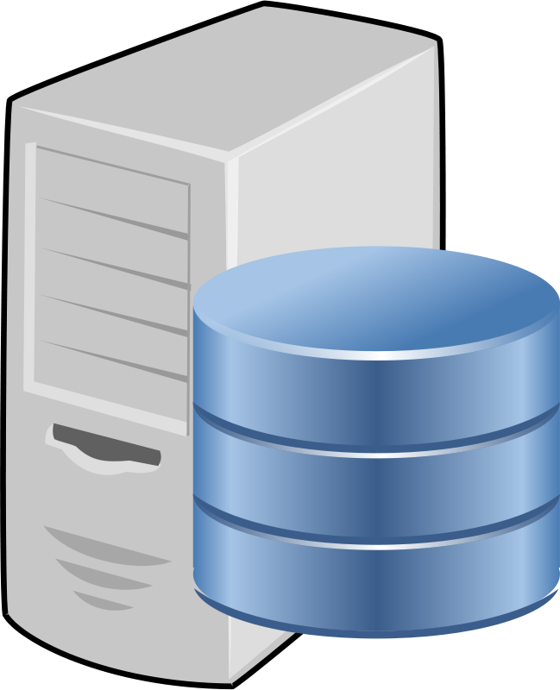
3-way Handshake
{SYN}
{SYNACK}
{ACK}

Slide 10
3. What is HTTP?

Slide 11

The HyperText Transfer Protocol (HTTP) is….
A protocol that runs over TCP
A service that runs on port 80
Meant for communication between a web browser and a web server
Available in different versions (1.0, 1.1, 2 ,3)
Communicated with formatted requests and responses

Slide 12
How HTTP communication works
Client HTTP Requests
Server HTTP Responses

Slide 13


How HTTP Communication Works
3-way Handshake
{SYN}
{SYNACK}
{ACK}
CLIENT (Us)
Web Server

Slide 14
How HTTP Communication Works
2. HTTP Request Packet is sent
HTTP Request
CLIENT (Us)
Web Server

Slide 15
How HTTP Communication Works
3. HTTP Response From Server
HTTP Response
CLIENT (Us)
Web Server

Slide 16
How HTTP Communication Works
4. Terminate Connection
{FIN}
CLIENT (Us)
Web Server

Slide 17
What’s going on in step 2?
2. HTTP Request Packet is sent
HTTP Request
CLIENT (Us)
Web Server

Slide 18
3. Headers & Requests

Slide 19

Let’s Investigate in WireShark
Let’s take a look at an HTTP packet captured on the network.
Recall: Wireshark is known as a “packet sniffing” tool and it allows us to read individual network packets that are being sent/received in the local area network.

Slide 20
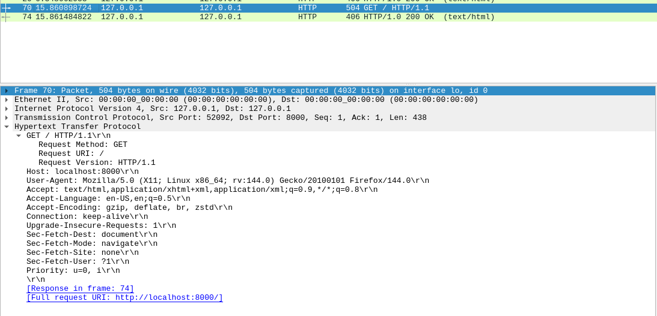

Slide 21
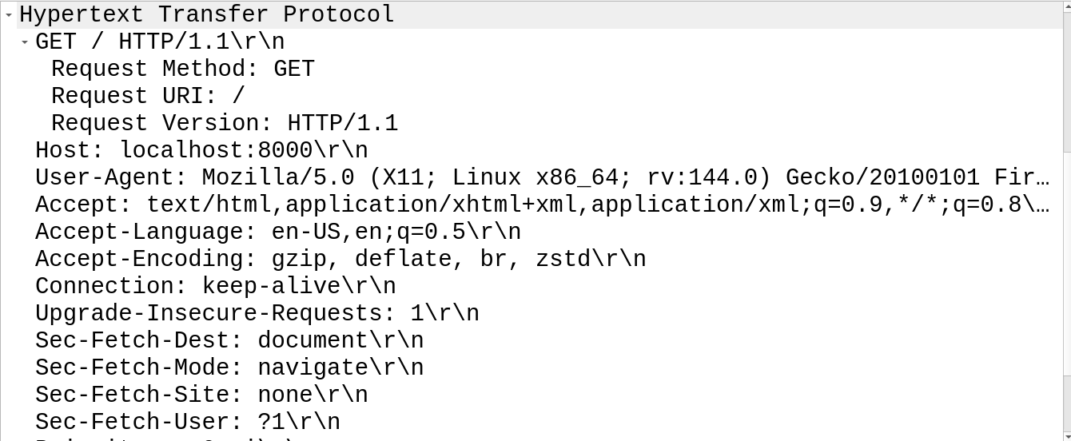

Slide 22
HTTP Requests
Packets of data requesting information from a web server in order to build the website on the client side.
Can be formatted in a variety of ways
Can be utilized to enumerate information from client and server
Notes:
2nd: Don’t Expect all http request to look the same
3rd: This is why https encrypts all this information

Slide 23
HTTP Requests Components
Request Line
First line of an HTTP Request and contains the following components:
HTTP Method (GET, POST, PUT, DELETE): Indicates the type of request being made
URI: The address of the data that the client wants to access (Webpage, Image, Document etc.)
HTTP Version: The HTTP Version that is being used (1.0, 1.1, 2, 3)
Notes:
2nd: Don’t Expect all http request to look the same
3rd: This is why https encrypts all this information

Slide 24
HTTP Request Methods
Method | Function
GET | Used to retrieve data from the server. Typically used when trying to load a webpage.
POST | Used to submit data to the server. Useful for login pages or creating accounts
PUT | Used to update or create a resource on the server at the URL. Intended for files uploads.
DELETE | Used to delete a resource on the server at the specified URL.
HEAD | Used to retrieve only the response headers from the server. Typically GET retrieves both the response headers and body.
OPTIONS | Used to retrieve information about the request methods available for a specific resource.
Notes:
HTTP Request Methods are automatically configured depending on what you are trying to do on the website.

Slide 25
HTTP Request Packet (Request Line)

Slide 26
HTTP Requests Components
Request Headers
Provide extra information about the requests and common ones include:
User-Agent: Information about the client’s web browser (browser type)
Host: Hostname of the server
Accept: The media types the client can handle in the response (HTML,JSON)
Authorization: Credentials for authentication if needed
Cookies: Information stored on the client side that is sent to the server with each request
Notes:
2nd: Don’t Expect all http request to look the same
3rd: This is why https encrypts all this information

Slide 27
HTTP Requests Components
Request Body
Some HTTP request methods allow additional data to be sent to the server
This part is optional in HTTP Requests
Put and Post are two methods that generally include Request Bodies
Notes:
2nd: Don’t Expect all http request to look the same
3rd: This is why https encrypts all this information

Slide 28
HTTP Request Packet (Headers & Body)

Slide 29
Now let's Take a look at the Responses

Slide 30
HTTP Response Components
Response Status-Line
The first line in a response packet
Displays HTTP Version
Displays the HTTP Status Code
Ex: ( 200 OK )
Notes:
2nd: Don’t Expect all http request to look the same
3rd: This is why https encrypts all this information

Slide 31
Common HTTP Status Codes
Status Code | Definition
200 OK | The request was successful and the server returned requested data.
301 Moved Permanently | The requested resource has been moved to a new URL.
302 FOUND | The requested resource is temporarily moved, commonly used in redirections.
400 BAD REQUEST | Request cannot be processed due to a client error.
401 UNAUTHORIZED | Authentication is required.
403 FORBIDDEN | The server received the request but the client does not have the permission to access the data.
404 NOT FOUND | The requested resource could not be found
500 INTERNAL SERVER ERROR | The Server encountered an error when trying to process the request.
Notes:
HTTP Request Methods are automatically configured depending on what you are trying to do on the website.

Slide 32
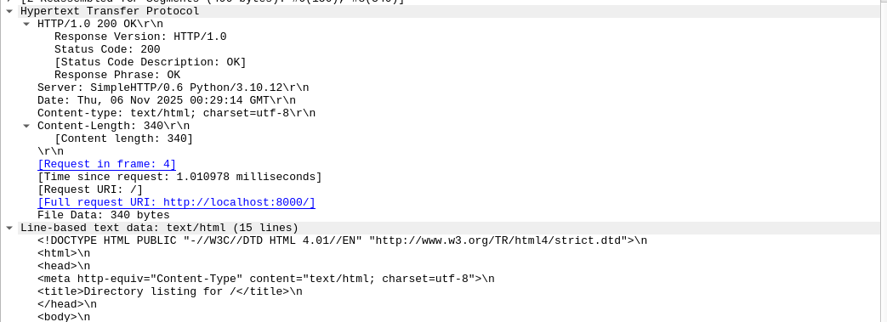
HTTP Response Packet (Status Line)

Slide 33
HTTP Response Components
Response Headers
These provide additional information about the response similarly to request headers, common ones include:
Content-Type: The media type of the response content
Content-Length: The size of the response body in bytes
Set-Cookie: Used to set cookies on the client side
Server: States type of web server utilized
Date: Time the response was sent
Can also include an optional Response Body
Notes:
2nd: Don’t Expect all http request to look the same
3rd: This is why https encrypts all this information

Slide 34
HTTP Response Packet (Headers & Body)

Slide 35
HTTP Vs. HTTPS
What’s the Difference?
HTTPS = HyperText Transfer Protocol Secure
HTTP transfer data over the internet with clear text
HTTPS encrypts data over the internet utilizing SSL/TLS
(Include pic of HTTPS packet)
Notes:
2nd: Don’t Expect all http request to look the same
3rd: This is why https encrypts all this information

Slide 36
HTTP Versions
HTTP 1.0 | HTTP 1.1 | HTTP 2 | HTTP 3
- First Version - Status Codes - Content Types - HTTP Methods | - Still Common - Can use a single TCP connection Multiple times AKA Connection: Keep-Alive | - Binary Protocol - Can send multiple requests at a time | - Uses QUIC protocol (Runs over UDP) - Faster Connections - Automatically encrypts all data
Notes:
2nd: Don’t Expect all http request to look the same
3rd: This is why https encrypts all this information

Slide 37
5. WireShark CTF
Notes:
Plans for participation: Have 3 easy flags one mystery optional one

Slide 38

6. ATTENDANCE

